Slide 1


Project Progress Report (OBKMS)
Viktor Senderov (@vsenderov)
Bulgarian Academy of Sciences/ Pensoft, Sofia Bulgaria
Advisor: Prof. L. Penev
PhD Financed through the EU Marie-Sklodovska-Curie Program
Grant Agreement Nr. 642241

Slide 2
PhD project plan published as a RIO paper
doi: 10.3897/rio.2.e775

Slide 3
Objective
The objective of this dissertation project is to develop and apply a semantic model and algorithms supporting knowledge extraction from biodiversity literature and its management in a semantic database.

Slide 4
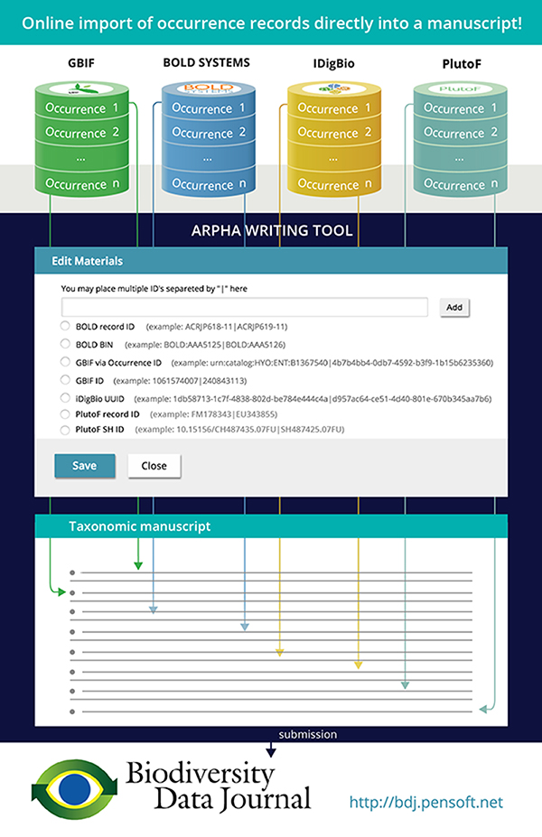
Progress so far 2015-2016
Wrote software allowing for the automated import of specimen records from GBIF, BOLD Systems, iDigBio, PlutoF into Pensoft’s ARPHA system
Wrote software allowing for the automated import of data papers into Pensoft’s ARPHA
Participated in dissemination of these workflows through various blog posts, presentations and webinars

Slide 5
Symposium Attendance
Conference EU-BON, 1 – 4 June 2015, Cambridge, UK: participated in seminars and workgroups.
Conference EMODNET, 8 – 9 June 2015, Crete, Greece: participated in workgroups: upcoming paper (second authorship) in RIO Journal: “EMODnet Workshop on mechanisms and guidelines to mobilise historical data into biogeographic databases”
Conference BEXIS, 9 – 19 July 2015, Jena, Germany: participated in seminars and workgroups.
6-th international Barcode of Life conference, 18 - 21 Aug. 2015, Guelph, Canada: did not participate but co-authorship of report „Streamlining scholarly publication of Barcode of Life data“.
Kick-off BIG4, 14 – 18 Sept. 2015, Copenhagen, Denmark: Introductory Talk : “Building the Open Biodiversity Knowledge Management System”.
EU-BON Training in Sofia, 22 – 24 March 2015, Talk: “Introduction to the ARPHA System”

Slide 6
What is next for 2016-2017?
Describe flow of biodiversity information as the Introduction to the PhD Thesis; use the examples from the practical experience in 2015-2016.
Lay the groundwork for information extraction from biodiversity literature by developing a semantic model (ontology) – 1’st major publication
Develop an algorithm for parsing materials citations based on repeated patterns – 2’nd major publication
Deployment of OBKMS semantic database!

Slide 7
What is next for 2017 – 2018?
Collaborate with BIG4 project partners
Use the OBKMS to explore biodiversity data and answer competency questions.
Further technological development.

Slide 8
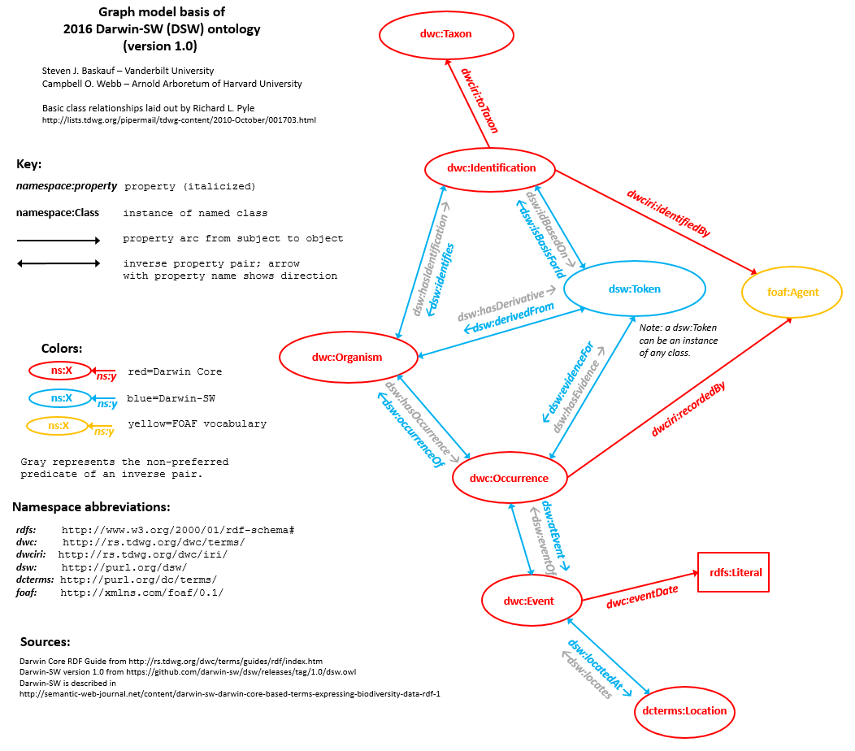
“A semantic model supporting information extraction from biodiversity literature”
OWL Ontology (Web Ontology Language)
Bibliographic classes (e.g. Treatment) linked to and taxonomic classes (e.g. Taxon Concept) via properties
Generation of named RDF graphs (quads) in the form of nano-publications from taxonomic papers
Storage of RDF in a graph database

Slide 9
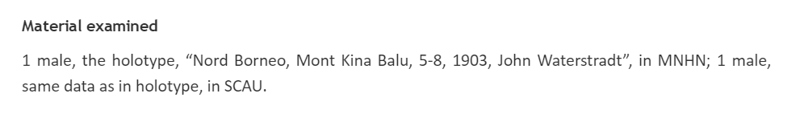
“An algorithm for parsing materials citations based on repeated patterns”
dwc:lifeStage
dwc:year
dwc:collectionCode
dwc:typeStatus
dwc:recordedBy
dwc:month, dwc:day
“location”

Slide 10
Modern Methods of Systematic Research
Student Discussion with Martin and Pavel

Slide 11
Definition (Species Rank Taxon)
A set of organisms in nature that form a natural group according to a species concept.
Notes:
One of the tasks of a taxonomist is to provide circumscriptions of taxa, providing evidence to the hypothesis that these taxa are natural groups according to a species concept.
https://github.com/tdwg/tcs/blob/master/TCS101/UserGuidev_1.3.pdf

Slide 12
What can a circumscription include?
Textual descriptions of traits that the organisms in the taxon exhibit
Citations of voucher specimens (types)
Technical drawings
Photographs
High-resolution 3D imaging
Genetic information
Comparison to closely related taxa (diff)
See http://zookeys.pensoft.net/about#TaxonomicTreatments
Notes:
All of this data could provide potential information to test the hypothesis “new species” given a particular species concept based on:
Ecology
Morphology
Genetics
Etc.

Slide 13
Need for machine-readable data
Since Karl Popper science is moving in the direction of providing falsifiable hypotheses, i.e. there must a formally defined algorithm operating on experimental data that could potentially (given the data) disprove the hypothesis. In order to accomplish this, taxonomic data must be made available in machine-readable format, and machine computable format.

Slide 14
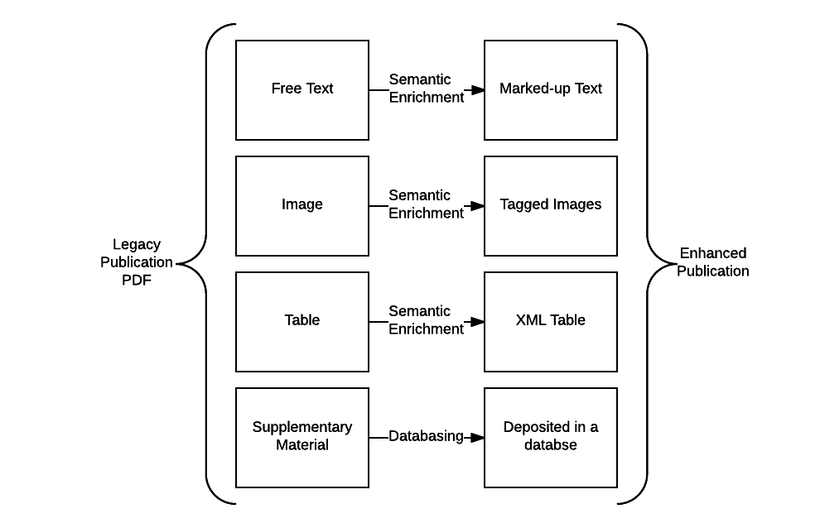
Information extraction from a biodiversity publication
Notes:
The information extracted in an enhanced publication is still “locked up” in individual XML files
Only individual queries possible with a complicated language XPATH, requiring in-depth knowledge of the structure of the XML
Solution: store the information in a database
Merging information from multiple publications and sources together allowing richer queries and easier reuse.

Slide 15
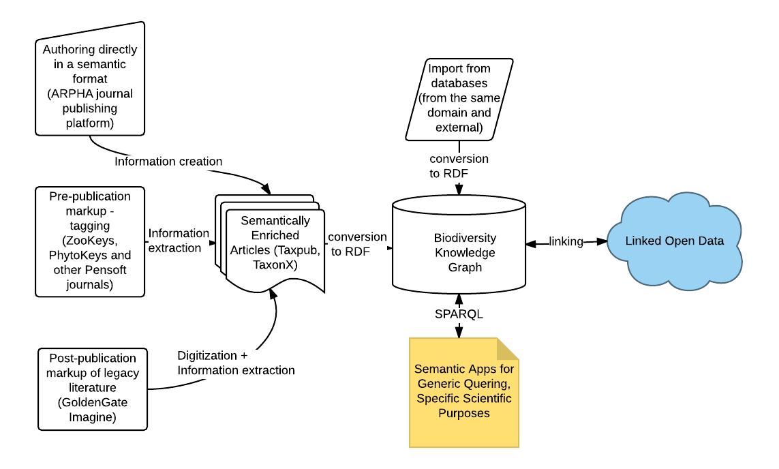
OBKMS Architecture

Slide 16
Taxonomic impediment
The Taxonomic Impediment: “worldwide shortage of taxonomists”
Majority of species undescribed
A lot of “dark taxa”: unnamed OTU’s
Rod Page, iPhylo blogspot, 12 April 2011

Slide 17
Turbo Taxonomy
“Integrative taxonomy on the fast track - towards more sustainability in biodiversity research”
Riedel et al. (2013)
DOI: 10.1186/1742-9994-10-15
Notes:
Turbo taxonomy aims for “fast” species descriptions in order to overcome the taxonomic impediment. An OTU delimited by a genetic algorithm is combined with a concise morphological description and high-resolution digital image in “taxonomic pipeline”.

Slide 18
BOLD Algorithm

Slide 19
Holistic Taxonomy
“Eupolybothrus cavernicolus Komerički & Stoev sp. n. (Chilopoda: Lithobiomorpha: Lithobiidae): the first eukaryotic species description combining transcriptomic, DNA barcoding and micro-CT imaging data”
Komericki & Stoev (2013):
doi: 10.3897/BDJ.1.e1013

Slide 20
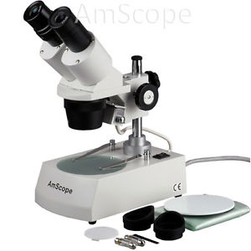
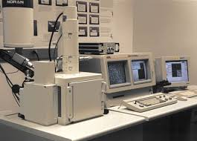
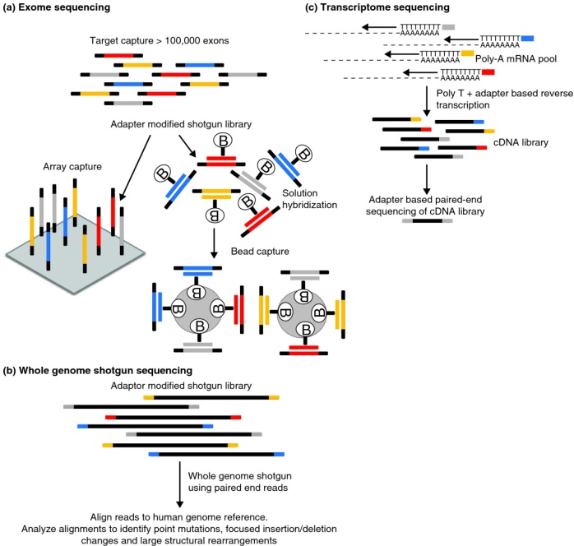
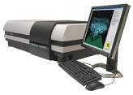
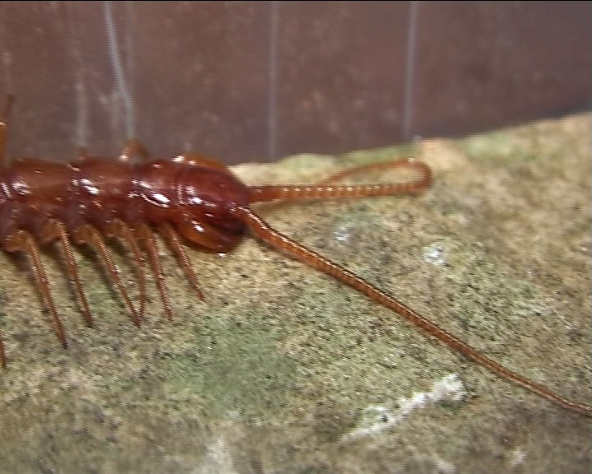
Methods of holistic taxonomy
Morphological study with a Zeiss microscope
SEM images
Mitochondrial Cytochrome C Oxidase Subunit I gene sequencing
Full transcriptome sequencing
Micro-CT scanning
Video of living specimen
Slide borrowed from Stoev.
Notes:
In the study the following methods were applied: Morphological study with a conventional and Scanning electron microscopy performed at NMNHS and ZMUC; next-generation molecular methods for sequencing the transcriptome of the new species performed at BGI-Shenzhen and DNA barcoding performed at Canadian Centre for DNA Barcoding Guelph and Micro-CT scanning at Bruker microCT.

Slide 21
Cybertypes
“Micro-computed tomography: Introducing new dimensions to taxonomy”
Faulwetter et al. (2013)
doi: 10.3897/zookeys.263.4261
“Micro-CTvlab: A web based virtual gallery of biological specimens using X-ray microtomography (micro-CT).”
Keklikoglou et al. (in press). Biodiversity Data Journal.

